Slide 1
Demo Scenarios for Pub/Sub Middleware
Steven Lai

Slide 2
Objective
To show the benefit of using my middleware
  Benefit: hide out the low-level details to make the application development easier
  How? By developing a sample application for traffic management.
  Requirements: the application must look like real world applications and must be easy to illustrate.

Slide 3
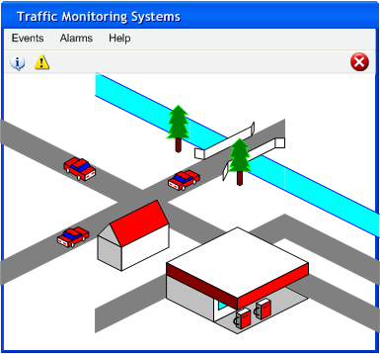
Interface
The main window shows the demo map – for defining events

Slide 4
Interface (cont’d)
Event menu: for subscribing / unsubscribing events
Alarm menu: for displaying the alarm status and history (last alarm, events which trigger the alarm).
Tool bar: quick access to the most commonly used events
Main window: display map which is to be used when some events are defined.

Slide 5
Predefined Events
Users should be able to easily define some commonly events
  Easily defining predicates for the events
Predefined events:
  Traffic jam event
  Traffic safety event
  Over-speeding event

Slide 6
Traffic Jam Event
Attributes:
  Area to be monitored
  Average speed to identify a traffic jam
  Average number of vehicles on each road to identify a traffic jam
  Position (road id) of the traffic jam.
Defining predicates:
  Area: selecting a box on the map
  Average speed: after selection, a box will pop up to allow the user to enter the speed.
  Average number of vehicles: input in the pop-up box
How it can be used in real applications:
  Post timely information to the drivers to be aware of the traffic jams
  Statistical information about positions of traffic jams can be used to identify which roads are mostly jammed.

Slide 7
Traffic Safety Event
Attributes:
  Area to be monitored
  Distance between two vehicles to identify a potential collision
  Speed difference of two vehicles to identify a potential collision
  Position (road id) of the event
Defining predicates:
  Area: selecting a box on the map
  Distance: input in the pop-up box.
  Speed difference: input in the pop-up box
How it can be used in real applications:
  Statistical information about positions of safety events can help to identify ‘black spots’.

Slide 8
Over-speeding Event
Attributes:
  Area to be monitored
  Speed of the vehicle
  Position (road id) of the event
Defining predicates:
  Area: selecting a box on the map
  Speed: input in the pop-up box
How it can be used in real applications:
  Statistical information about positions of over-speeding events can help to identify ‘black spots’.

